Slide 1
Alcoholic liver disease
&
Circulatory disorders of the liver.
Prof. J. Hewavisenthi
Department of Pathology

Slide 2

Alcoholic liver disease
Sequential progression in 10 – 15 years with continued intake of Alcohol.
  Hepatic steatosis
  Alcoholic hepatitis
  Cirrhosis

Slide 3
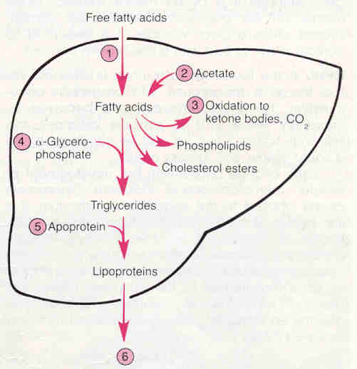
Pathogenesis of Fatty liver

Slide 4
Steatosis (Fatty liver)
Pathogenesis
  1. Increased synthesis of TGL – because of increased delivery of FA to liver. Eg: Starvation, Malnutrition and DM
  2. Decreased FA oxidation – mitochondrial injury – Eg: Hypoxia and Anaemia.
  3. Decreased synthesis & release of lipoproteins. – Eg: Hepatotoxins, malnutrition, CCL4, P

Slide 5
Steatosis (Fatty liver)
Pathogenesis contd.
  4. Rate of conversion of FA to TGL increased. (alcohol is an enzyme inducer)

Slide 6
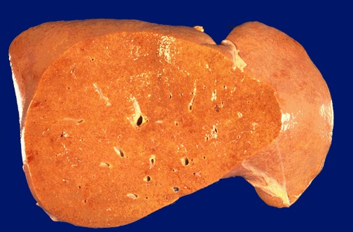

Pathology
Macroscopy
Enlarged liver.
Capsule smooth and glistening
Cut surface – yellow and greasy.

Slide 7
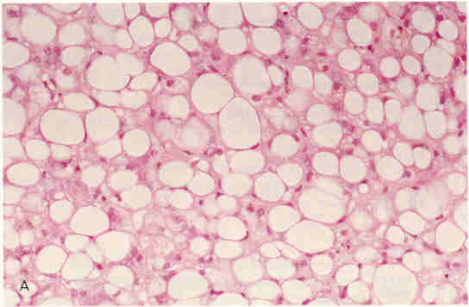
Pathology
Microscopy
Initially – microvesicular
Macrovesicular
Lipogranuloma/ fatty cysts
Mainly in the perivenular region ( Zone – 1)
Perivenular Pericellular Perisinusoidal fibrosis.

Slide 8
Clinical features
Asymptomatic
Anorexia, malaise, nausea, vomiting and abdominal discomfort.
Hepatomegaly
Jaundice
Raised aminotransferase levels

Slide 9
Non alcholic fatty liver disease (NAFLD)
Associations
  Obesity
  Diabetes mellitus
  Malnutrition
  Hyperlipidaemia
  Drugs –
  Jejunoileal by pass

Slide 10
Non alcholic fatty liver disease (NAFLD)
  Spectrum disease which includes
  Steatosis
  Steatohepatits
  Cirrhosis (Varying degrees of fibrosis)

Slide 11
Alcoholic Hepatitis
Clinical features
  Asymptomatic
  Fulminant hepatic failure
  Malaise, nausea anorexia, loss of weight, raised serum transaminases, fever, leucocytosis.
  Cholestastic syndromes.

Slide 12
Alcoholic Hepatitis
Follows bouts of drinking
Superimposed on pre existing alcoholic steatosis or cirrhosis
Outcome – variable.
Absistence – can lead to reversal / subsiding / progression.

Slide 13
Pathology
Liver cell necrosis – single scattered foci marked by clusters of neutrophils. (Mainly in the perivenular region.)
Inflammation – Portal tracts Lobular around necrotic cells.
Fibrosis – Perivenular Pericellular
Mallory bodies / hyaline - Hepatocytes having eosinophilic waxy cytoplasmic inclusions. (perivenular)

Slide 14
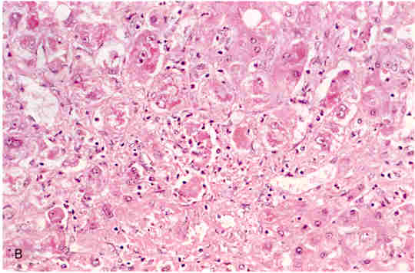
Mallory bodies
Also seen in
  PBC
  Wilson’s disease
  Indian childhood cirrhosis
  Chronic cholestastic Syndromes
  Focal nodular hyperplasia
  Hepatocellular carcinoma

Slide 15
Circulatory disorders of the Liver
Chronic passive congestion
Central haemorrhagic necrosis (Acute venous congestion )
Cardiac sclerosis
Hepatic vein thrombosis
Hepatic veno – occlusive disease
Portal vein obstruction and thrombosis leading to Portal hypertension.

Slide 16
Chronic passive venous congestion
Aetiology –
  Right heart failure (CCF/ Tricuspid disorders)
  Rarely – obstruction to vena cava / Hepatic veins.

Slide 17
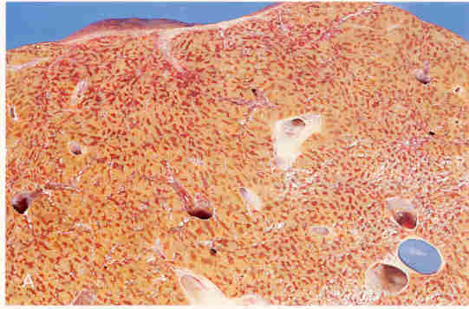
Macroscopy
Dusky red cyanosis increased liver size and weight.
Cut surface – ooze of blood with prominent central veins
Surrounded by uncongested liver substance – yellow in colour.
NUT MEG LIVER

Slide 18
Microscopy
Central vein and vascular sinusoids congested
Central hepatocytes are atrophic due to severe hypoxia.
Peripheral hepatocytes show steatosis due to less severe hypoxia.

Slide 19
Central haemorrhagic necrosis
Occurs with severe cardiac failure as in shock.
Macroscopy – slight depression of necrotic lobular center.
Microscopy –
  Central hepatocytes necrotic.
  Centrilobular zone haemorrhagic.
  Fatty change of portal hepatocytes not prominent. (more acute condition)

Slide 20
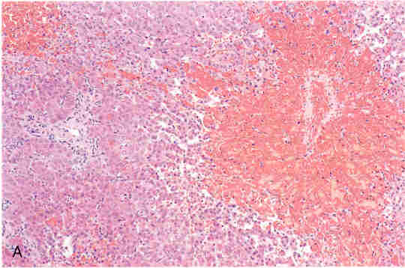
Central Haemorrhagic necrosis

Slide 21
Cardiac sclerosis
Fibrosing condition that follows long standing CPC and or Centrilobular necrosis.
Macroscopy –
  Liver slightly decreased in size.
  Fine pig skin grain on the surface
  C/S – slight depression of the centrilobular region. But congested and prominent.

Slide 22
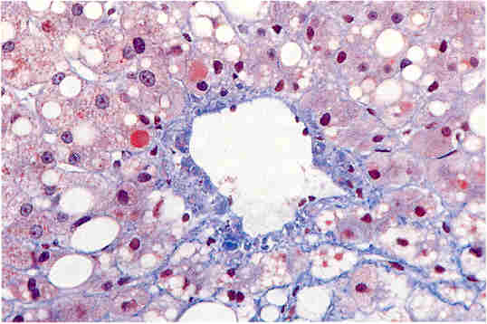
Cardiac sclerosis
Microscopy – Increased fibrosis around CV fanning into the parenchyma.

Slide 23
Budd – Chiari Syndrome
Causes
  Thrombosis of hepatic veins
  Polycythaemia rubra vera
  Pregnancy
  Oral contraceptive pills
  Paroxysmal nocturnal haemoglobinuria.
  Intra abdominal carcinoma – HCC
  Rare – constrictive pericarditis RA myxoma

Slide 24
Budd Chiari Syndrome
Clinical features – Hepatomegaly, Ascites, Adominal pain.
Jaundice absent or very mild.
Macroscopy – Swollen red – purple liver with tense capsule.

Slide 25
Budd Chiari Syndrome
Microscopy –
  Subtotal involvement seen.
  Centrilobular congestion and necrosis with marked distension of sinusoids.
  Above leads to rupture into the spaces of Disse.
  Slowly developing lesions Cardiac sclerosis

Slide 26
Hepatic veno occlusive disease
Subendothelial sclerosis with thickening and obliteration of smaller vessels and central veins within the liver.
Indistinguishable from slowly progressive Budd Chiari Syndrome.
Causes –
  Alkaloids found in bush tea. (Jamaican)
  Antineoplastic drugs.
  Immunosuppresants.
  Hepatic irradiation.
  Graft vs host disease.

Slide 27
Portal vein obstruction
Better tolerated than obstruction of hepatic vein.
Clinical features
  Ascites
  Oesophageal varices
  Bowel infarction
  Caput medusae.

Slide 28
Causes of Portal vein obstruction
  INTRA HEPATIC
  Cirrhosis
  Carcinoma of the liver.
EXTRA HEPATIC
  Peritoneal sepsis – portal pyelophlebitis.
  Intra abdominal malignancy
  Pancreatitis.
  Post surgical thrombosis
  Aplasia of Portal vein.

Slide 29
Portal Hypertension
Pressure in the portal veins exceeding 10mm Hg.
Collateral circulation develops in
  Submucosa of the oesophagus(lower) and stomach (upper) –( Varices )
  Submucosa of the Anorectal junction (Haemorrhoids)
  Anterior abdominal wall around the umbilicus (Caput medusae)
  Between left renal vein and splenic vein.
  In the falciform ligament.

Slide 30
Causes of Portal vein obstruction
Pre hepatic
  Portal vein thrombosis
  Splenic vein thrombosis
Intra hepatic
  Cirrhosis
  Non cirrhotic – Nodular regenerative hyperplasia, Alcoholic, drug induced Hepatitis, Hepatic fibrosis,
Post hepatic
  Veno occlusive disease
  Budd – Chiari Syndrome
  Congestive cardiac failure.

Slide 31
Pathogenesis
Flow rate
Increased resistence
  Hepatocyte enlargment
  Nodular regeneration
  Impaired elasticity of the sinusoidal wall
  Perivenular fibrosis.
  ( Intrahepatic vascular resistence)

Slide 32
Clinical features
Haematemsis
Haemorrhoids
Caput medusae.
Splenomegaly – Hypersplenism.
Ascites. *

Slide 33
Ascites
Accumulation of serous fluid within the peritoneal fluid.
Features
  Umbilical eversion
  Abdominal distension
  Hernia
  Striae.

Slide 34
Ascites
Pathogenesis
  Portal hypertension increases the hydrostatic pressure.
  Decreased Albumin synthesis leads to reduction in the oncotic pressure.
  Increase hepatic lymph formation.
  Retention of Sodium and water – secondary hyperaldosteronism.

